Slide 1

The data class a.k.a. the Pandas class (but it’s not)
Pietro Berkes & Verjinia Metodieva

Slide 2

Hands-on What data structure would you use to represent…

Slide 3
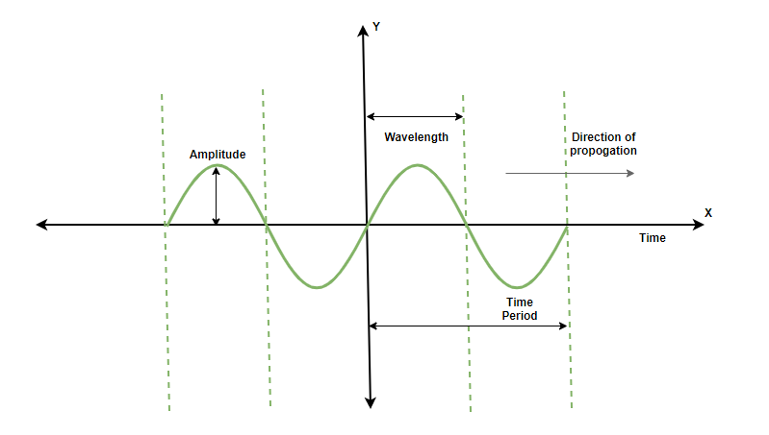
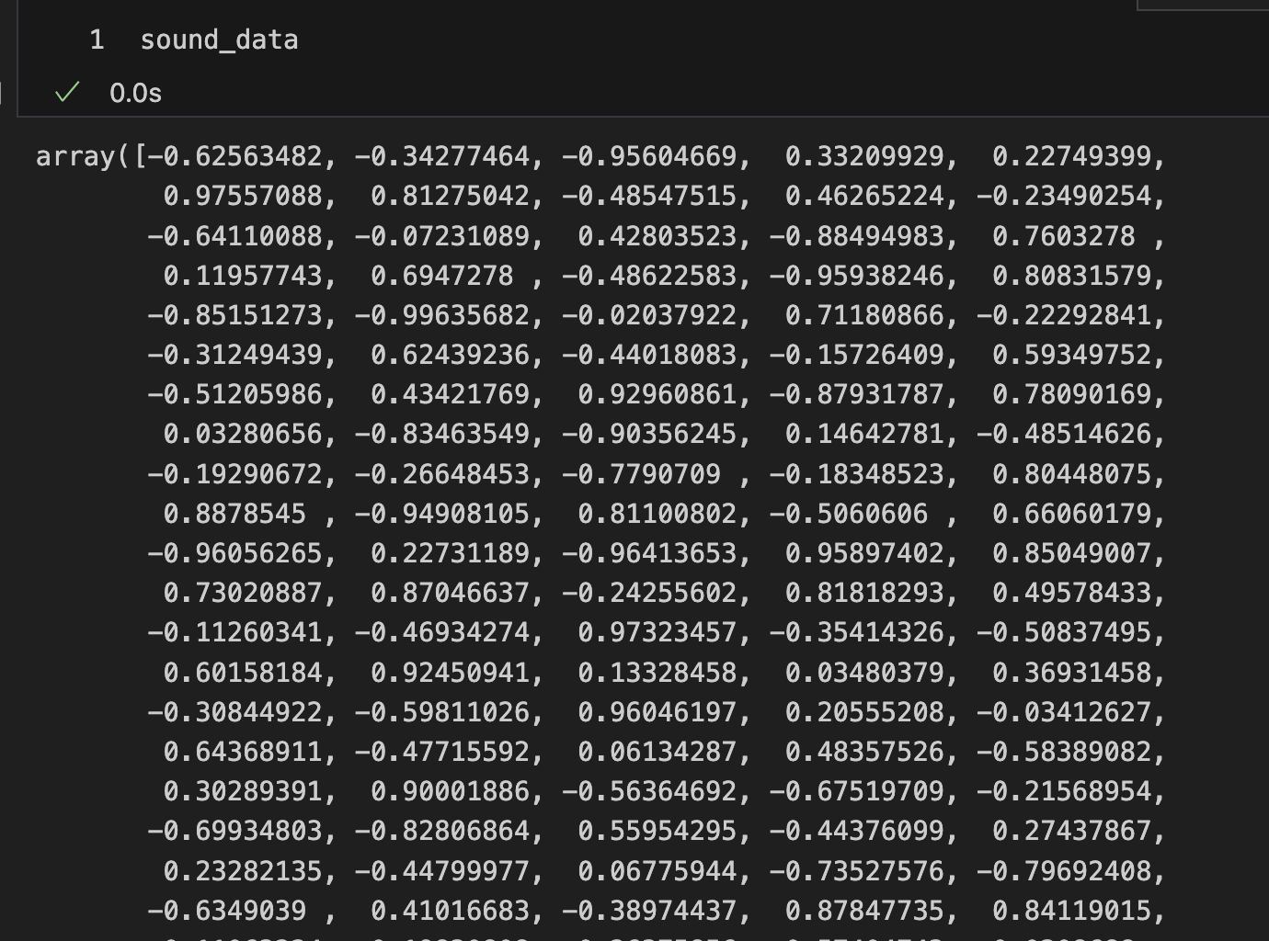
Hands-on What data structure would you use to represent…
a sound wave?
NumPy array

Slide 4
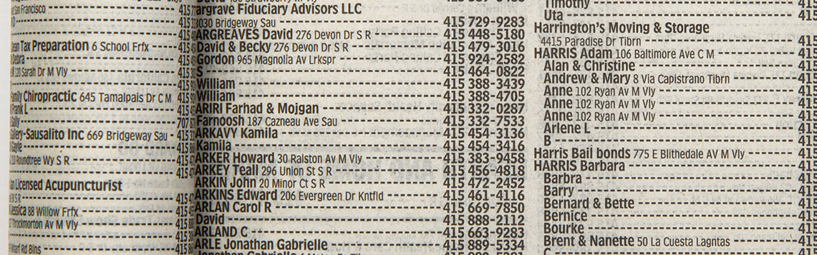
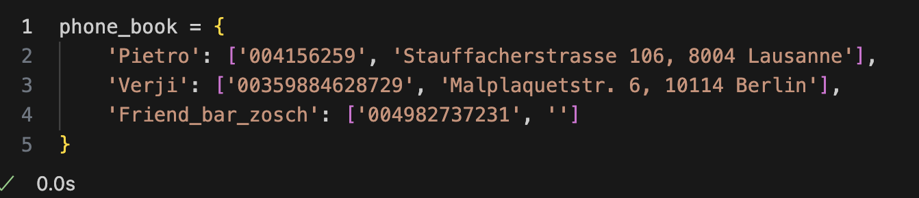
Hands-on What data structure would you use to represent…
phone book entries?
dictionary
maybe this one with a table?

Slide 5
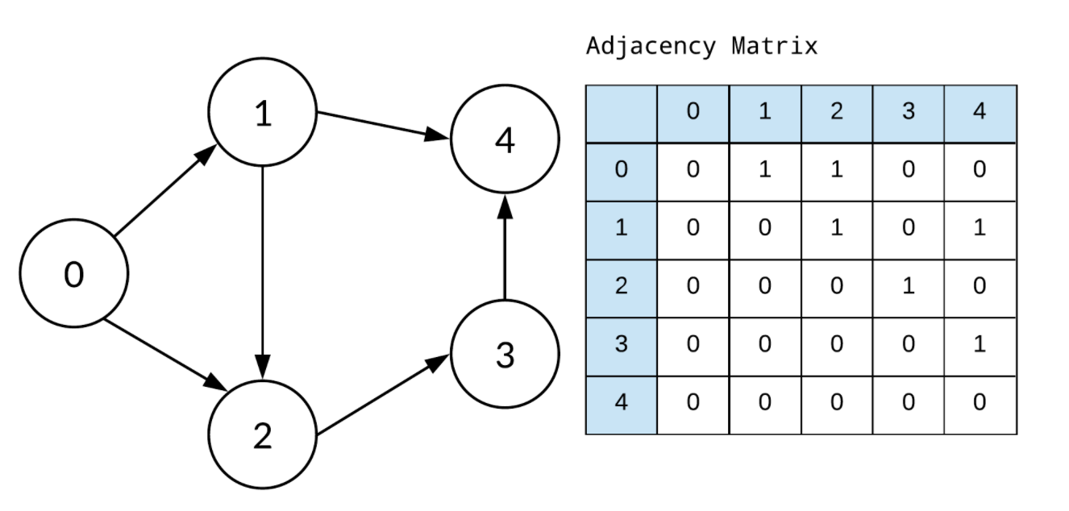
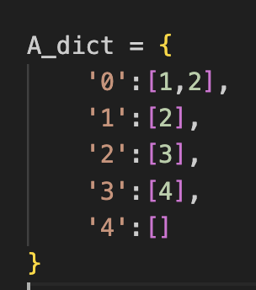
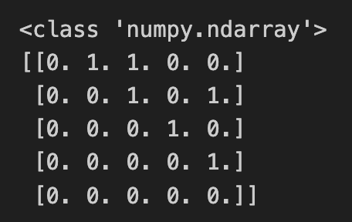
Hands-on What data structure would you use to represent…
OR
a graph?
dictionary
adjacency matrix
NumPy array
obvious but: different data structures are for storing different things
What are the criteria for picking a data structure over another?

Slide 6
Things to think about when choosing a data structure
Processing
Storage
Reproducibility and collaboration
Efficient processing (no for-loops!)
Organizing data so that analyses are easy
Size
Access ease
Access time
Versioning
Lineage tracing (which script / other data was used to generate this?)
Ease of sharing

Slide 7
You develop your code on a small data set, how is it going to scale to the complete data set?
Development data
Real data
N data points,
Processing time T
10x N data points
Processing time -> ?
We’re interested in orders of magnitude
Notes:
Data and code are related.
Nice transition from the last question. In extreme case, when the relations in the graph are dynamic/ changing a lot →using a dictionary is not a good solution. Instead, when small dataset and we are mainly interested in visualizing the relations, it might be.
The NumPy array solutions, scales much better, in case there are hundreds of dynamically changing relations to inspect.

Slide 8
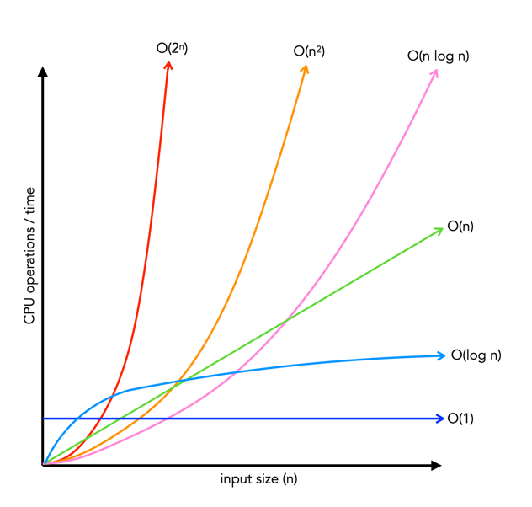
How performance scales: big-O
Big-O class | What we call it | Time increase, when data increases 10x
O(1) | constant | 1x time
O(n) | linear | 10x time
O(n²) | quadratic | 100x time
O(n * log n) | linearithmic | ~10-20x time
O(log n) | logarithmic | ~1-2x time
O(2^{n})
O(n²)
O(n log n)
O(n)
Time
O(log n)
O(1)
Input size, n

Slide 9
Hands-on: Complexity of operations on lists
Big-O class | What we call it | Time increase, when data increases 10x
O(1) | constant | 1x time
O(n) | linear | 10x time
O(n²) | quadratic | 100x time
O(n * log n) | linearithmic | ~10-20x time
O(log n) | logarithmic | ~1-2x time
O(2^{n})
O(n²)
O(n log n)
O(n)
Time
Big-O class | Operation on lists that scales this way
O(1)
O(n)
O(n²)
O(n * log n)
O(log n)
O(log n)
O(1)
Input size, n

Slide 10
Hands-on: Complexity of operations on lists
Big-O class | What we call it | Time increase, when data increases 10x
O(1) | constant | 1x time
O(n) | linear | 10x time
O(n²) | quadratic | 100x time
O(n * log n) | linearithmic | ~10-20x time
O(log n) | logarithmic | ~1-2x time
O(2^{n})
O(n²)
O(n log n)
O(n)
Time
Big-O class | Operation on lists that scales this way
O(1) | Getting an element by its index
O(n) | Summing elements in list
O(n²) | Computing distance between all pairs of elements in the list
O(n * log n) | Sorting the list
O(log n) | Searching an element in a sorted list
O(log n)
O(1)
Input size, n

Slide 11

Example: Find common words
Given two lists of words, extract all the words that are in common
Expected result: ['apple', 'orange', 'banana']

Slide 12

Implementation with two for-loops
What is the big-O complexity of this implementation?

Slide 13
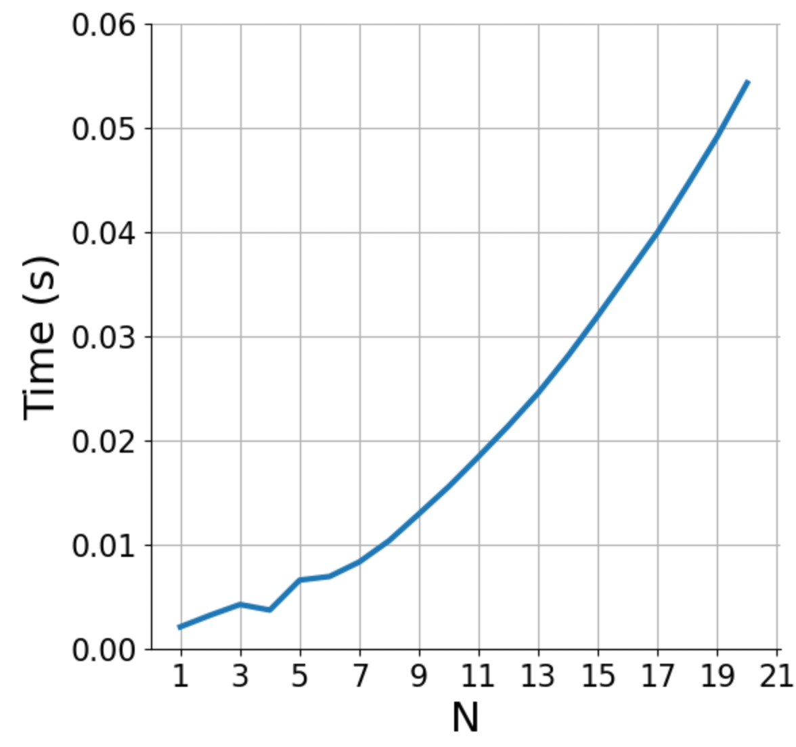
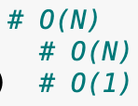
Implementation with two for-loops
What is the big-O complexity of this implementation?
N * N ~ O(N²)

Slide 14
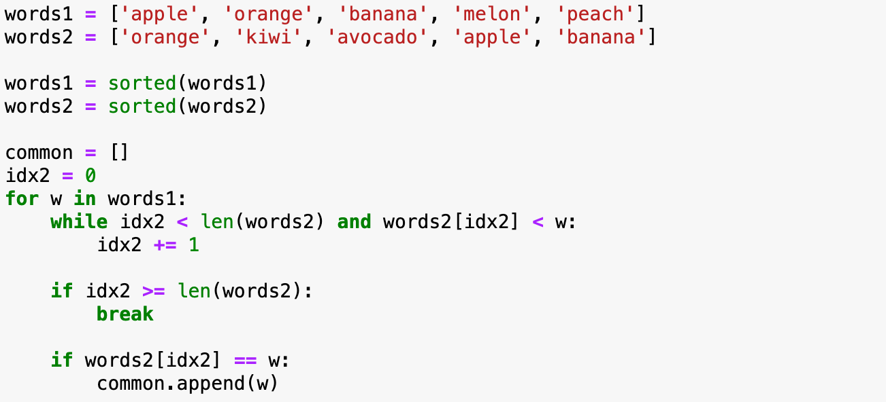

Implementation with sorted lists
What is the big-O complexity of this implementation?

Slide 15
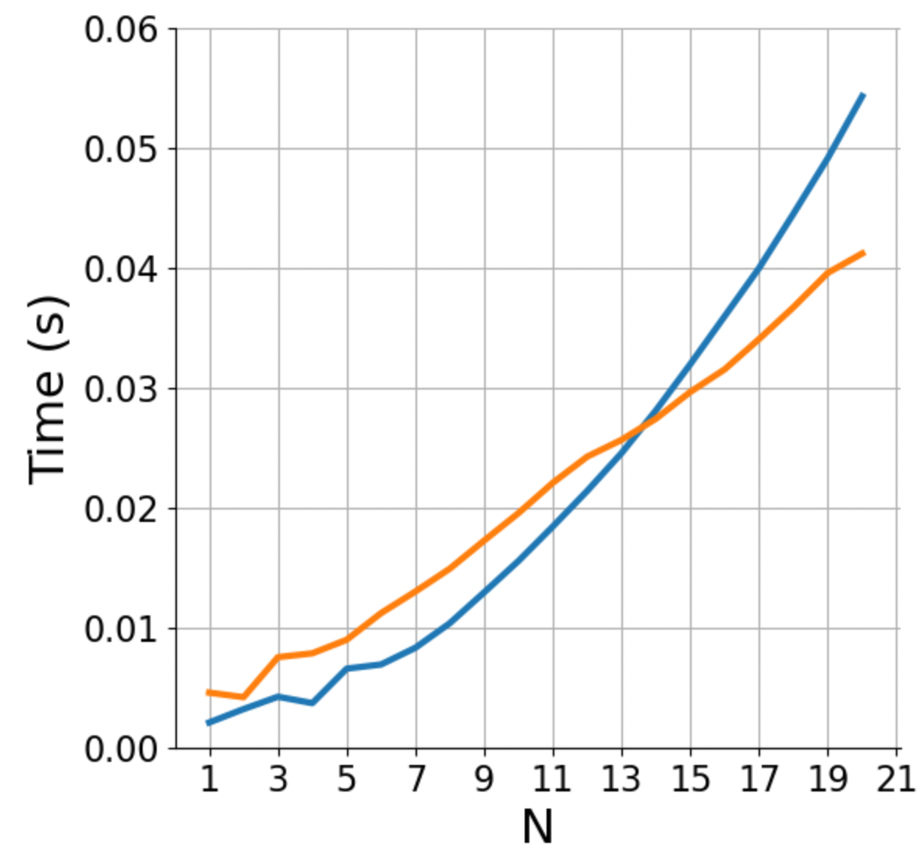

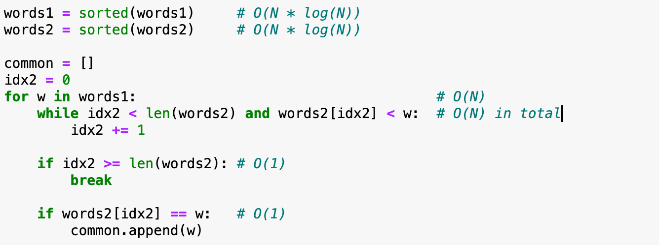
Implementation with sorted lists
What is the big-O complexity of this implementation?
2 * (N * log(N)) + 2 * N ~ O(N log N)

Slide 16
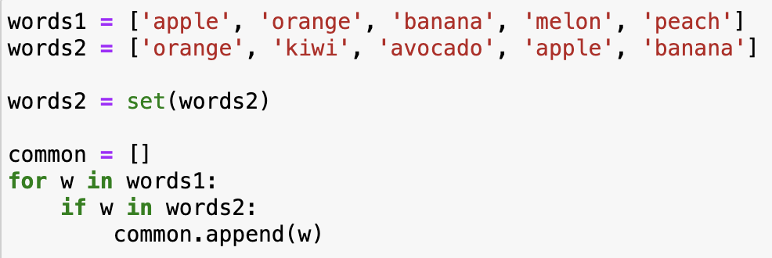
Implementation with sets
What is the big-O complexity of this implementation?

Slide 17
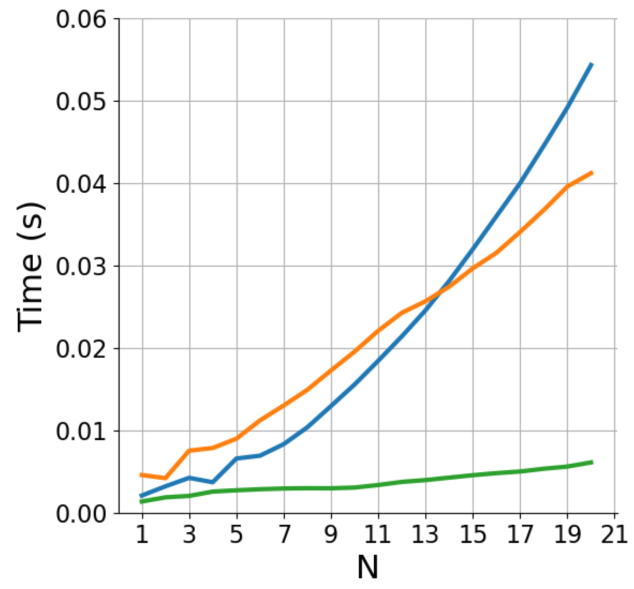
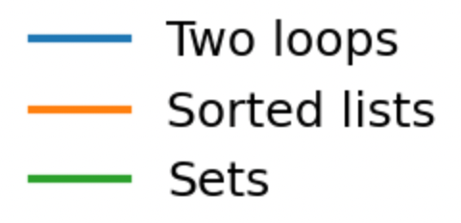
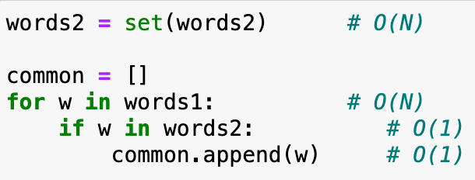
Implementation with sets
It’s the exact same code as for lists, but now looking up an element in sets (if w in words2) takes constant time!
How could you have known that set lookup is fast? Learning about data structures!
What is the big-O complexity of this implementation?
N + N ~ O(N)

Slide 18
Basic reference sheet about Python data structures
Lists: collection of ordered, arbitrary data
Dictionaries (“hashmaps”)
Inserting | O(1)
Finding a value by key (e.g., “if element in my_dict: …”) | O(1)
Getting an element by index | O(1)
Appending | O(1)
Inserting an element at index | O(n)
Sorting | O(n log n)
Finding an element (e.g., “if element in my_list: …”) | O(n)
Sets: it’s dictionaries without values
Inserting | O(1)
Finding a value by key (e.g., “if element in my_set: …”) | O(1)
See also: https://wiki.python.org/moin/TimeComplexity
Notes:
Note that there may be different implementations of these data structures with different complexities, these are for the Python implementation.
E.g., if finding an element in a list is important, one could implement it as two dictionaries, one mapping indices to data, one mapping data to indices. Finding out the complexities of all the operations with this implementation is left as a homework.

Slide 19
Hands-on
Exercise
exercises/anagrams
You are given an English dictionary containing M words (“the dictionary”), and a separate list of N words (“the input”)
For each word in the input, find all the anagrams in the dictionary (e.g., for input 'acme' the anagrams are ['acme', 'came', 'mace’])
Write an algorithm to solve this problem, and compute its Big-O class
Submit a PR for Issue #? on GitHub

Slide 20
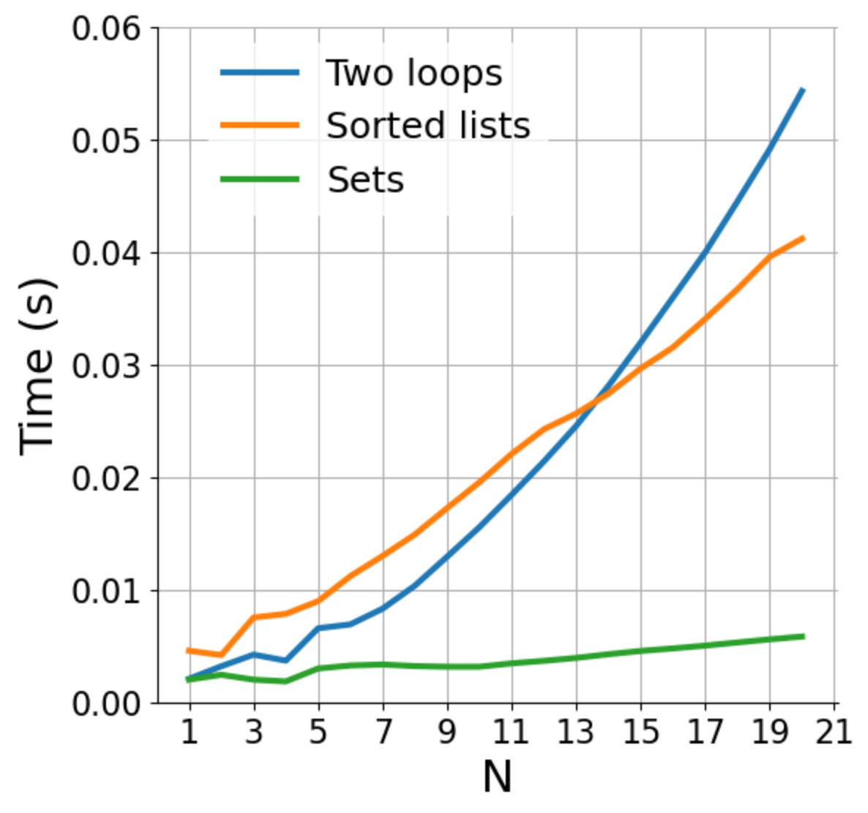
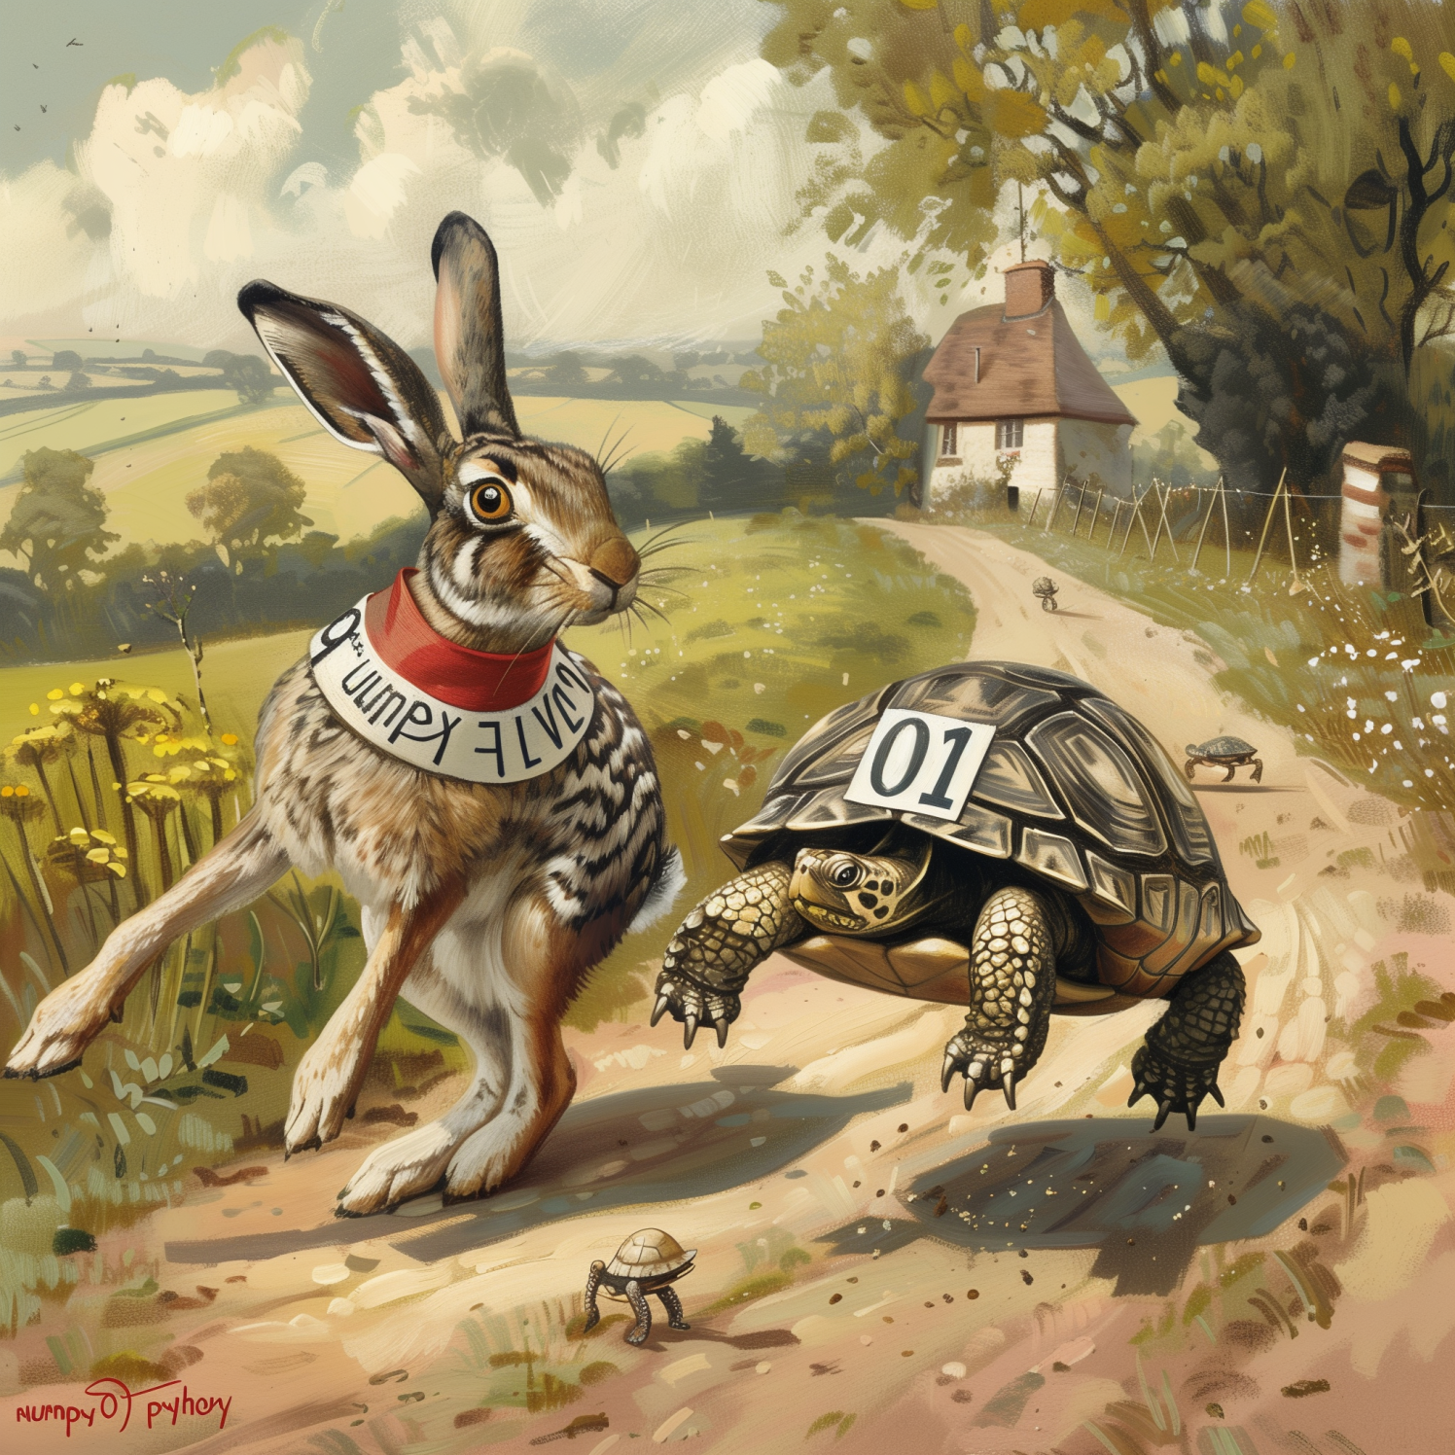
How does parallelization influence the performance?
Fast execution
Slow scaling O(n²)
Fast code
O(n²)
Regular code
O(n log n)
Slow execution
Fast scaling O(n log n)
Notes:
Parallelization lowers the curves.
For a fixed code, linear code is no necessarily faster.
Important when n is growing
Parallelization/ optimization → you can make the code faster for any fixed N, but the shape (of growth) can never change

Slide 21
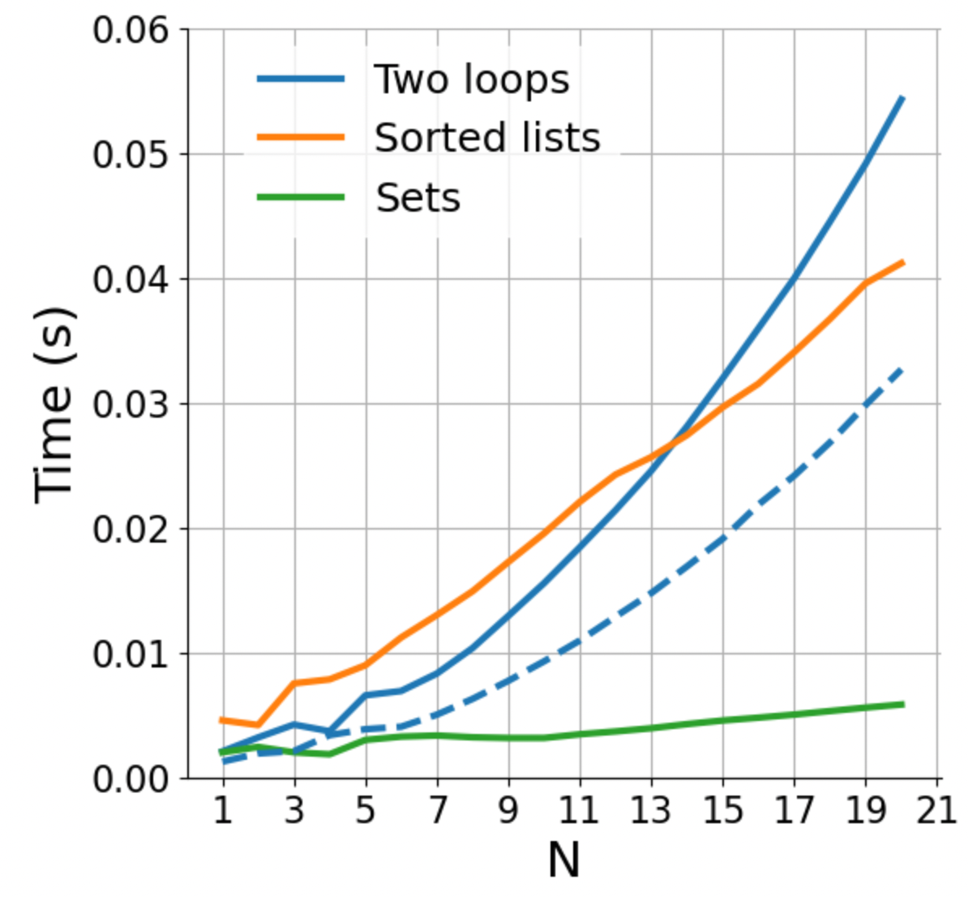
How does parallelization influence the performance?
Parallelization increases performance for fixed N
Fast code
O(n²)
Regular code
O(n log n)
Notes:
Parallelization lowers the curves.
For a fixed code, linear code is no necessarily faster.
Important when n is growing
Parallelization/ optimization → you can make the code faster for any fixed N, but the shape (of growth) can never change

Slide 22
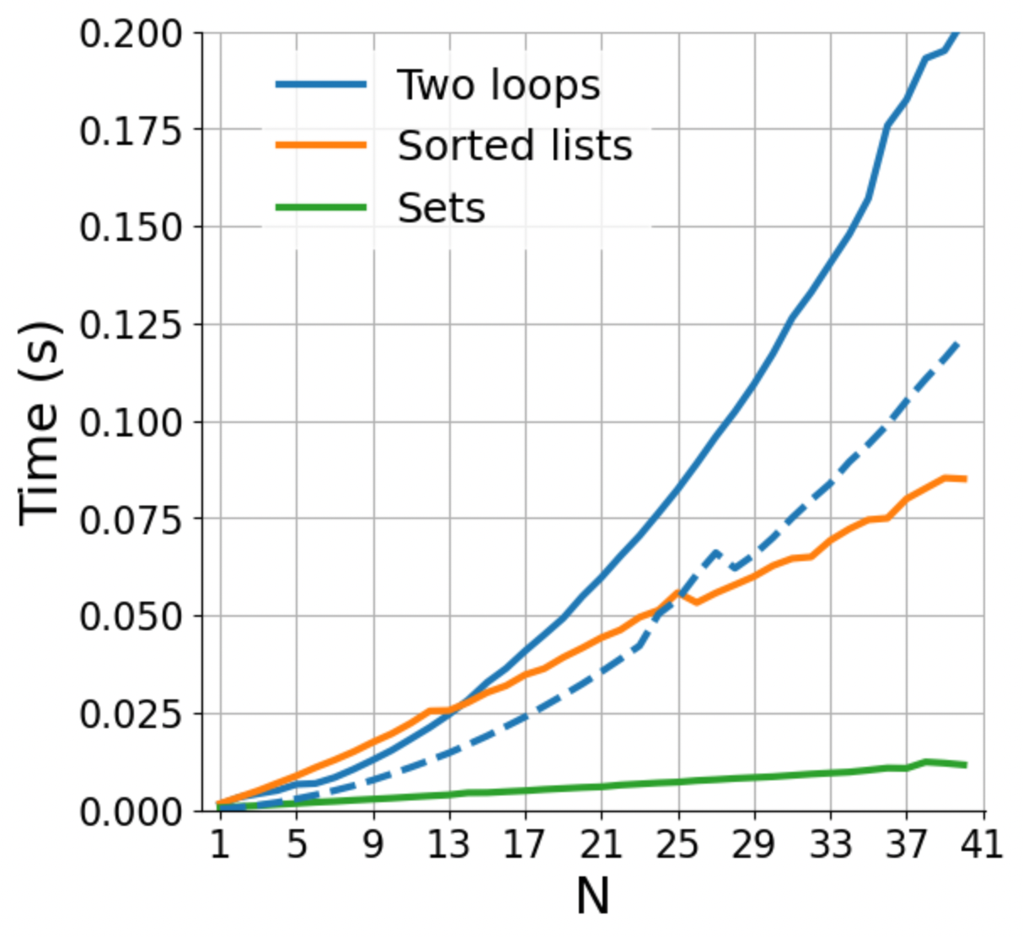
How does parallelization influence the performance?
Fast code
O(n²)
Regular code
O(n log n)
Notes:
Parallelization lowers the curves.
For a fixed code, linear code is no necessarily faster.
Important when n is growing
Parallelization/ optimization → you can make the code faster for any fixed N, but the shape (of growth) can never change

Slide 23
How does parallelization influence the performance?
Fast code
O(n²)
We need to distinguish between “fast” in absolute terms for a fixed problem size, and “fast” in the sense of how well it scales
Regular code
O(n log n)
Notes:
Parallelization lowers the curves.
For a fixed code, linear code is no necessarily faster.
Important when n is growing
Parallelization/ optimization → you can make the code faster for any fixed N, but the shape (of growth) can never change

Slide 24
COMING UP NEXT: NumPy and the array data structure

Slide 26
Data structures
This is an open question to the class
Which data structures do you know?
What makes you choose a data structure over another?
What do you consider, when thinking about data?
Notes:
Open questions and we collect the ideas on the whiteboard

Slide 27
All the data structures
list: ordered, heterogeneous storage, stack/queue, fast access by index, slow search
set: unordered
dictionary
arrays: e.g. numpy, HDF5
tables: e.g. pandas, dask, spark, SQL
graph: social network structure
tree: to rapidly search a dataset
heap
stack
queue
priority queue

Slide 28

We need to distinguish between “fast” in absolute terms for a fixed problem size, and “fast” in the sense of how well it scales
Fast code
O(n²)
Regular code
O(n)
Slow execution
Fast scaling O(n)
Parallelizing, rewriting in faster language
Fast execution
Slow scaling O(n^2)
Notes:
Parallelization lowers the curves.
For a fixed code, linear code is no necessarily faster.
Important when n is growing
Parallelization/ optimization → you can make the code faster for any fixed N, but the shape (of growth) can never change

